Slide 1


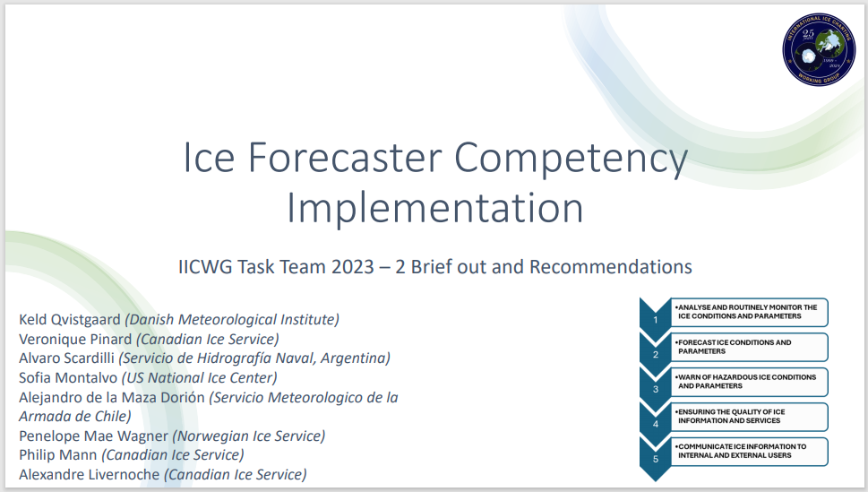






Slide 2

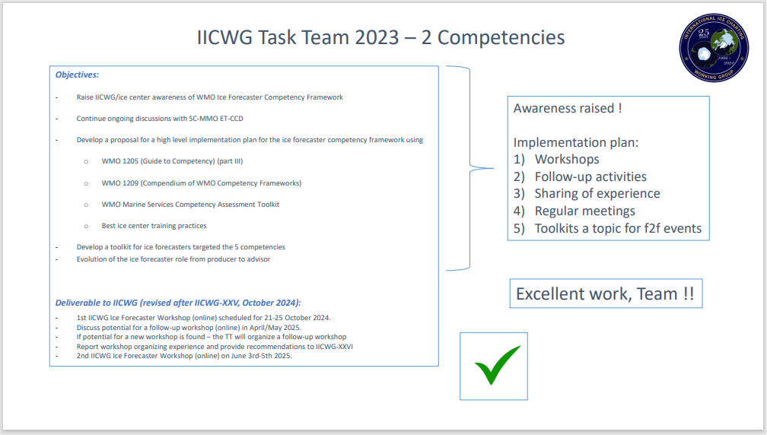

Slide 3
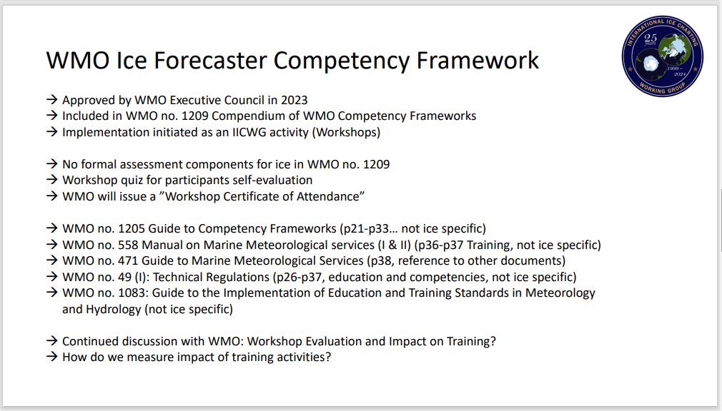

Slide 4
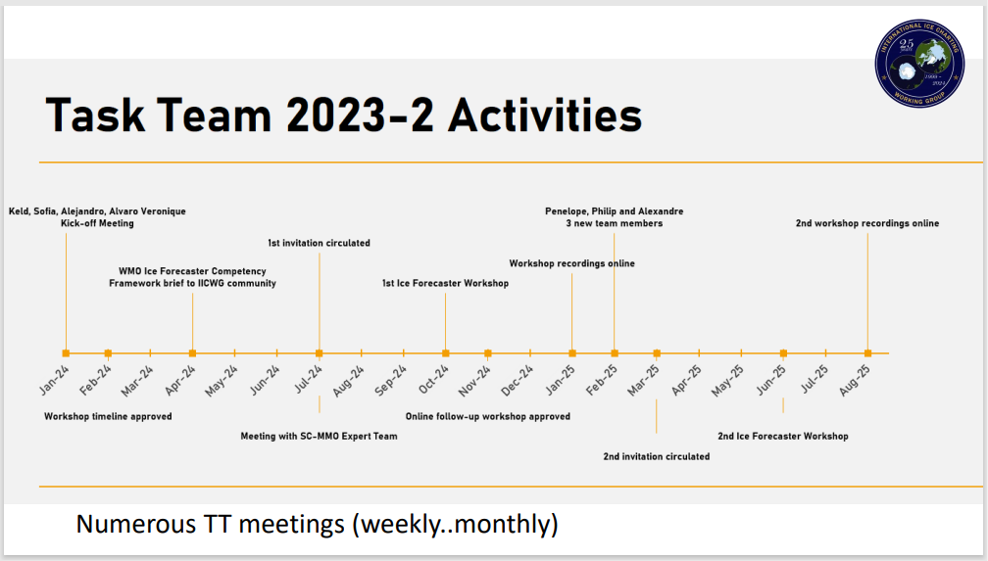

Slide 5

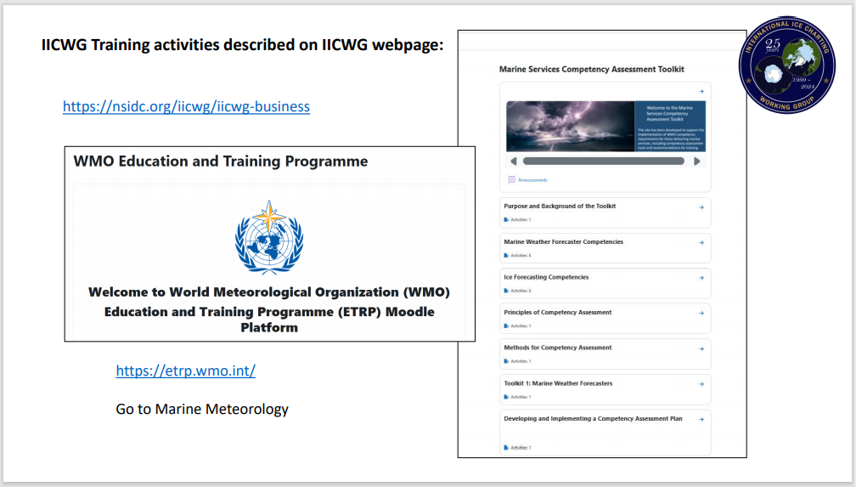

Slide 6
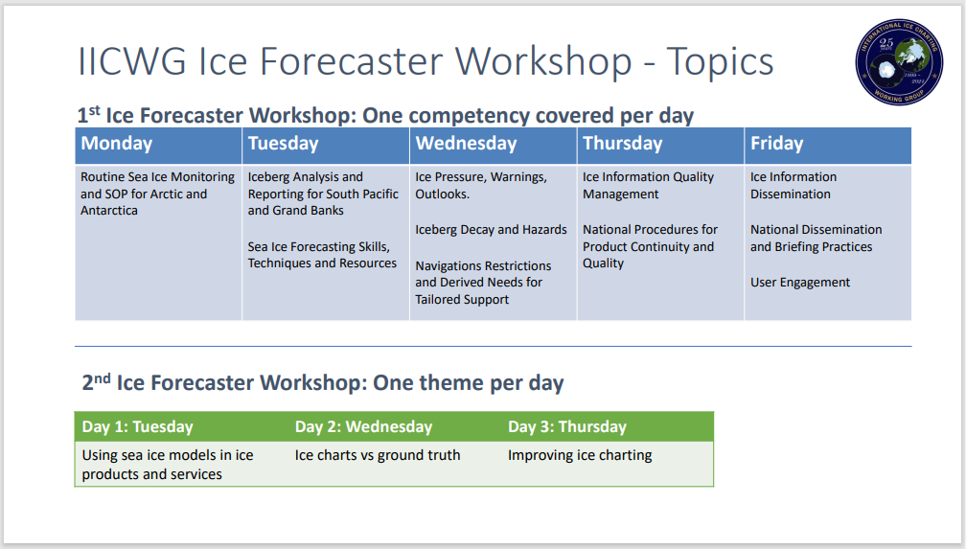

Slide 7
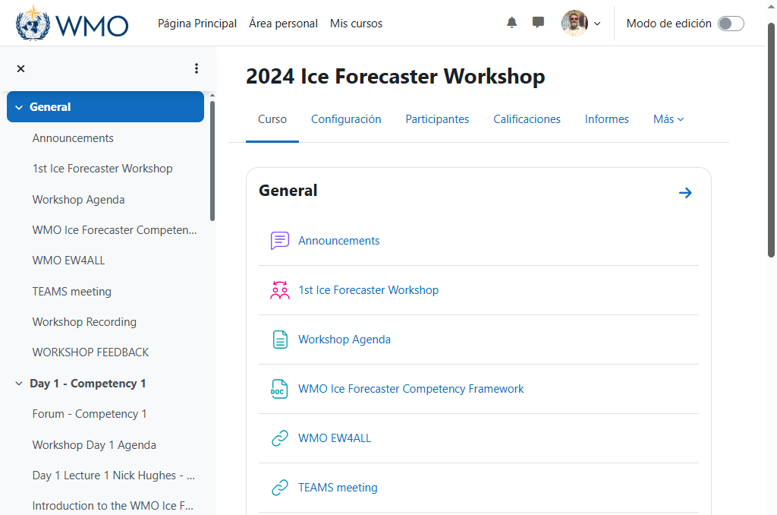

Slide 8
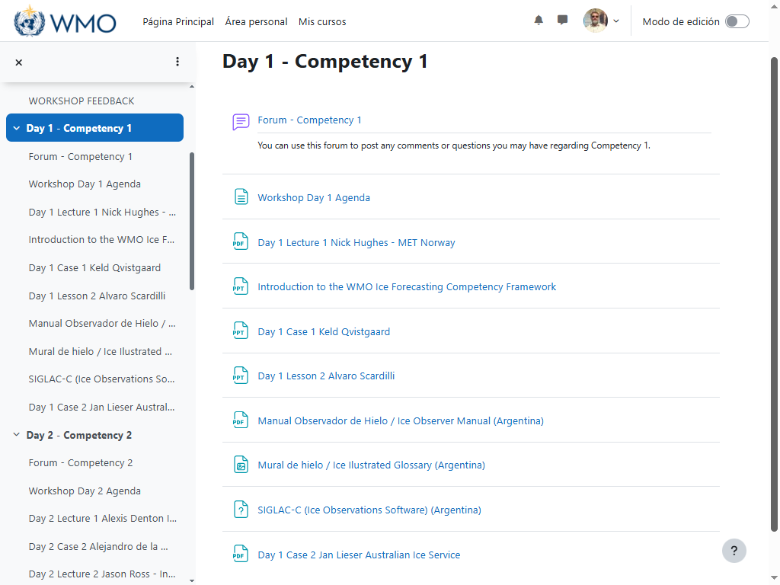

Slide 9
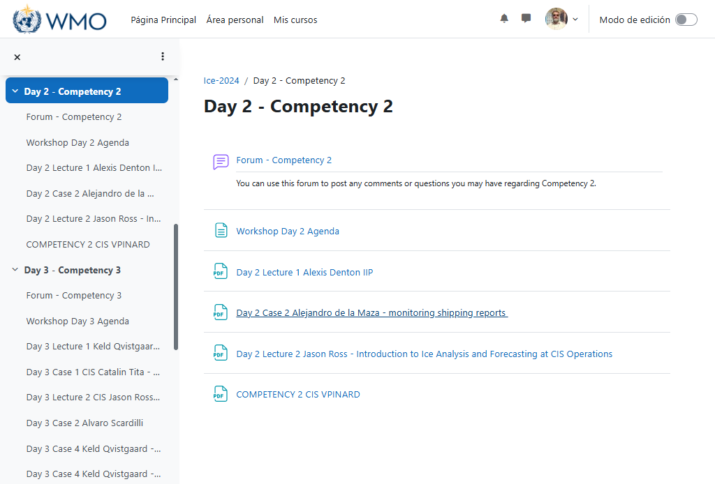

Slide 10
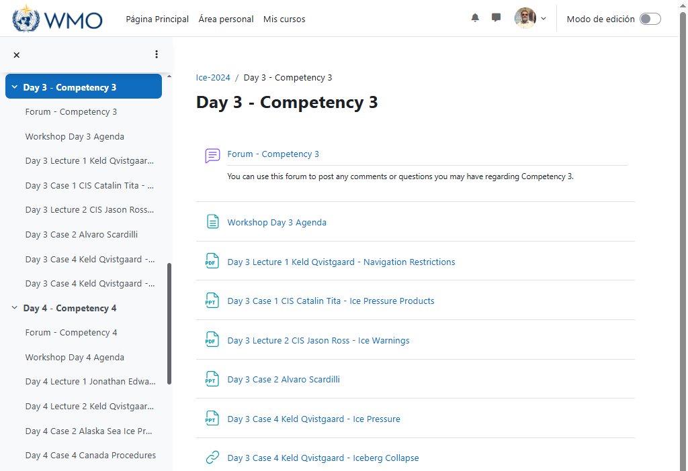

Slide 11
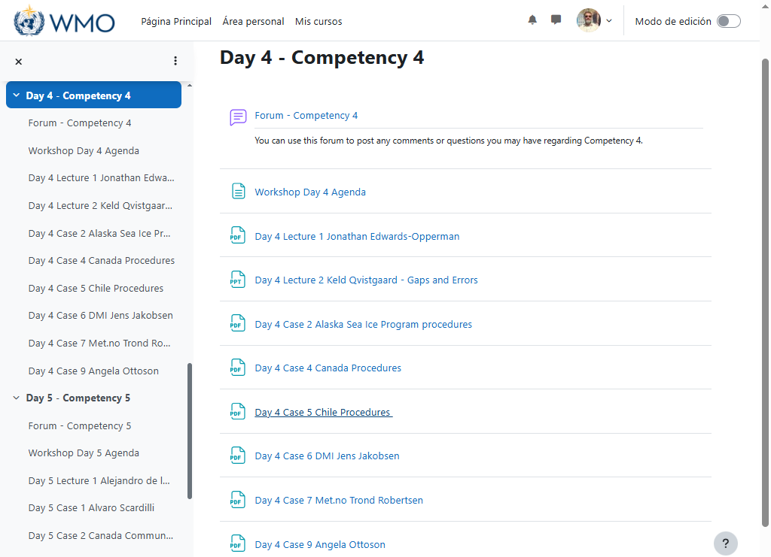

Slide 12
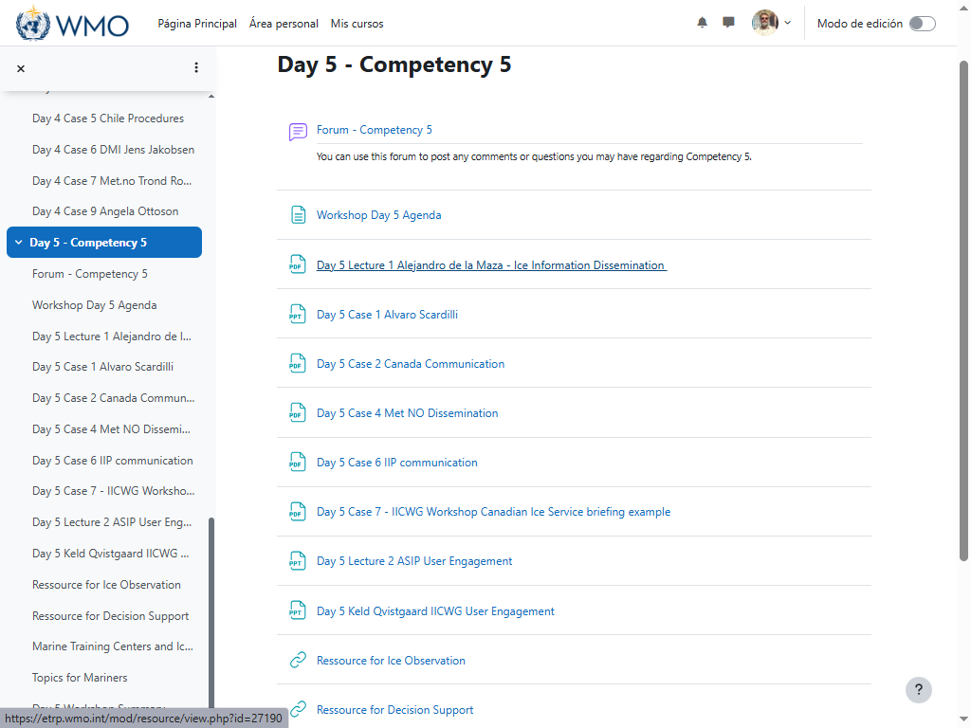

Slide 13
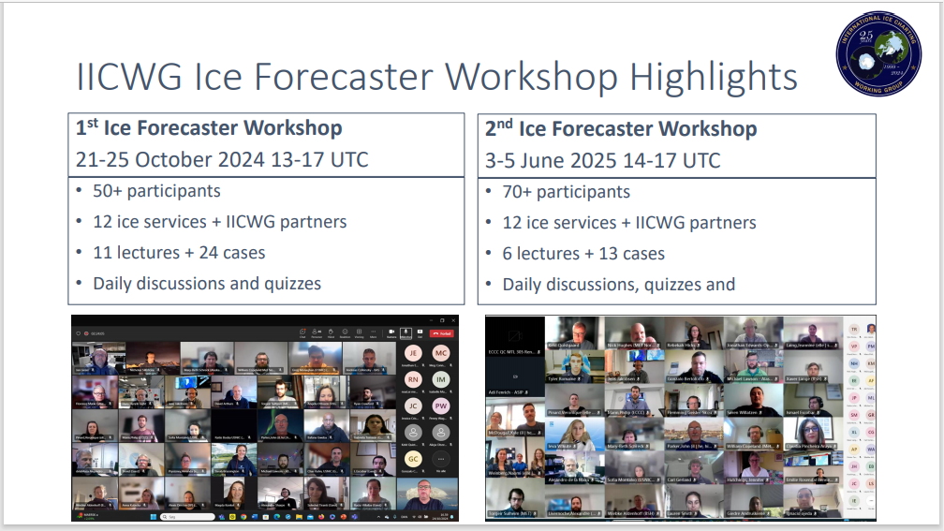

Slide 14
COMPETENCY 1: ANALYSIS AND ROUTINE MONITORING OF ICE CONDITIONS AND PARAMETERS
Description:
Integrate multiple remote sensing, meteorological and oceanographic data sources and auxiliary data sources to continuously monitor ice conditions.
Use applicable geographic information systems and local standard operating procedures to produce timely and accurate sea ice analyses.
Determine the need to issue, cancel, or modify/update forecasts and advisories in accordance with documented thresholds and regulations.
Performance criteria:
Use effective and appropriate near real-time satellite data, relevant derivative products, and on-site observations when monitoring and analyzing ice conditions;
Compare current forecasts and warnings with current ice conditions;
Based on monitoring/analysis of ice conditions and parameters, warnings issued by other ice services and model guidance, assess the need to modify forecasts and update warnings with respect to established and documented criteria.

Slide 15
Prior knowledge, skills and abilities:
Knowledge of ice products (routine and non-routine), their issuance times and the priorities applied in the region.
Knowledge of potential ice hazard conditions and events for specific regions.
Knowledge of unusual weather conditions and local effects that trigger ice pressure warnings, rapid closure of coastal roads, and special ice warnings.
Knowledge of meteorological techniques and ice analysis (subjective and objective).
Knowledge of the physics of sea ice.
Knowledge of relevant observation systems, platforms, and sensors, which may include remote sensing (satellite altimeters, microwave sensors); radar; in-situ sensors (anchored wave buoys, drifting buoys, bottom pressure sensors, ice thickness sensors); human observation procedures (ship, shore) and how their advantages and limitations vary with respect to prevailing seasonal, weather, or ice conditions .
Knowledge of bathymetry, coastal geomorphology, marine climatology, ocean currents, any local marine phenomena, local climate systems and their possible impacts on the movement, development, melting and decomposition of ice in the area of responsibility.
The ability to perform manual/subjective analysis (including analysis techniques in areas with scarce data)
The ability to perform image analysis related to ice.
The ability to translate information from automated products to routine ice products.
The ability to apply statistical analysis, geographic information systems processes, and other information techniques to data that have a geographic or geospatial aspect.

Slide 16
COMPETENCY 2: FORECAST OF ICE CONDITIONS AND PARAMETERS
Description:
Forecasts of ice conditions and parameters are prepared and published according to documented requirements, priorities, and timelines.
Demonstrate a good practical knowledge of the processes that produce climate, the characteristics and behavior of synoptic and mesoscale climate systems, and the physics and dynamics of sea ice.
Use this knowledge to forecast the movement, development, melting, and destruction of ice.
Performance criteria:
Analysis and diagnosis of the conditions and parameters of the ice necessary for the preparation and issuance of forecasts.
Prepare forecasts for relevant ice conditions and parameters such as (but not limited to):
a) ice concentration; b) size of floating ice; c) stage of ice development; d) ice movements; e) ice freezing time; f) ice breaking time; g) ice deformation; h) iceberg movement and decomposition.
(3) Ensure that forecasts are prepared and issued in accordance with national standard operating procedures (SOPs), including format, codes and technical regulations on content, consistency, accuracy and timeliness.
(4) Ensure that forecasts of ice conditions and parameters are consistent (spatially and temporally) across the boundaries of the area of responsibility to the greatest extent possible, while maintaining scientific integrity. This will include monitoring forecasts/warnings issued for other regions and liaising with adjacent regions as needed.

Slide 17
Prior knowledge, skills and abilities.
Knowledge of methods for predicting meteorological, oceanographic and ice conditions and their application (including those required by the application of regional variations)
Knowledge of the performance of forecasting models (deterministic models and ensemble prediction systems), including weather, ocean, ice, and wave models.
Knowledge of remote sensing applications.
Knowledge of uncertainties and confidence in the derivative or automated products used as inputs in routine ice products.
Knowledge of forecasting systems (including the use of software).
Knowledge of the areas of responsibility (local and regional) and in particular, of the planned boundaries and associated observation sites.
Knowledge of planned broadcast times and work priorities.
Knowledge of the types and characteristics of waves and swells, generation and decay of waves and swells, and characteristics of waves in shallow waters.
Knowledge of the physics and dynamics of sea ice and freshwater ice.
Knowledge of ocean or tidal currents and sea level.
The ability to predict the extent, thickness, concentration, stage of development, drift, deformation, growth, melting of sea ice and the size of icebergs.
The ability to predict icebergs and their movement or disintegration.

Slide 18
COMPETENCY 3: WARNINGS OF HAZARDOUS ICE CONDITIONS AND PARAMETERS
Description:
Warnings are issued in a timely manner when hazardous conditions are expected to reach documented threshold values and are updated, modified, or canceled, as appropriate, according to documented criteria.
These conditions and parameters are generally likely to damage ships and equipment and pose threats to the safety of maritime navigation and fishing activities.
Performance criteria:
Warnings about the following hazardous ice conditions and parameters, including their spatial extent, onset/cessation, duration, intensity and temporal variations: a) Ice pressure warnings; b) Rapid closure of coastal ice channels; c) Special ice warnings; d) Icebergs.
Ensure that warning products are prepared and issued in accordance with thresholds for hazardous ice conditions and parameters according to national criteria, including formats, codes and technical regulations on content, accuracy and timeliness;
Ensure that warnings about hazardous ice conditions and parameters are consistent (spatially and temporally) across the boundaries of the area of responsibility, while maintaining meteorological integrity to the extent possible. This will include monitoring forecasts and warnings issued for other regions and liaising with adjacent regions as needed.

Slide 19
Prior knowledge, skills and abilities:
Knowledge of the criteria for warnings.
Knowledge of ice warning criteria and associated amendment criteria.
Ability to use and clearly communicate the results of forecasting models (deterministic models and ensemble prediction systems).
Knowledge of local and regional areas of responsibility and alert limits.
Ability to use relevant alert communication systems.

Slide 20
COMPETENCY 4: GUARANTEE THE QUALITY OF INFORMATION AND FLOATING ICE SERVICES
Description: Forecasts, warnings, and related products are provided within a quality management framework.
Performance criteria:
Apply the organization's quality management systems and quality control procedures as needed;
Apply international standards on ice terminology;
Evaluate the impact of known characteristics of observational error (e.g., bias, achievable precision, and limitations of observations and detection methods) on forecasts and warnings;
Verify and validate data, products, forecasts and warnings about ice (timeliness, integrity and accuracy), using real-time verification tools;
Monitor the operation of operating systems, collect and evaluate customer feedback, suggestions and complaints, and take corrective action when necessary;
Identify and assess problems related to ice forecasting and warnings and determine appropriate corrective and preventive actions for continual improvement.

Slide 21
Prior knowledge, skills and abilities.
Knowledge of the principles, practices and procedures of quality management.
Knowledge of the criteria for forecasting and alerting.
The ability to use verification and statistical techniques.
Knowledge of contingency plans.
Knowledge of relevant stakeholder operations and forecasting needs and applications, including:
Stakeholder operations (e.g., procedures, tactics, processes, and planning cycles)
Stakeholder limitations, including operational limits, legal restrictions, and geopolitical boundaries.
Desired results for the stakeholders of the operation.
General knowledge of stakeholder terminology, such as nautical terms, acronyms, abbreviations, technical terms related to forecasting variables (e.g., ice concentration, stage of development, thickness, ice movement, freezing, ice deformation, sea state, currents, swell, tides) and knowledge of customer-preferred units of measurement.
Knowledge of the communication and security systems of the stakeholders, if necessary.
Knowledge of the impact of ice conditions and parameters on the operations and activities of stakeholders.

Slide 22
COMPETENCY 5: COMMUNICATE ICE INFORMATION TO INTERNAL AND EXTERNAL USERS
Description:
Ice forecasts and warnings are communicated in a timely and clear manner to meet the needs of the user community.
Participate in professional consultations and seek to understand the needs of users.
Performance criteria:
Ensure that all forecasts and warnings are disseminated through authorized communication channels to user groups;
Provide ice information sessions as needed and offer consultations to meet the specific needs of users;
To make use of forecasts and warnings of meteorological parameters, variables and phenomena to describe their impact on maritime operations, safety of life and property, including the coastal environment and the population.

Slide 23
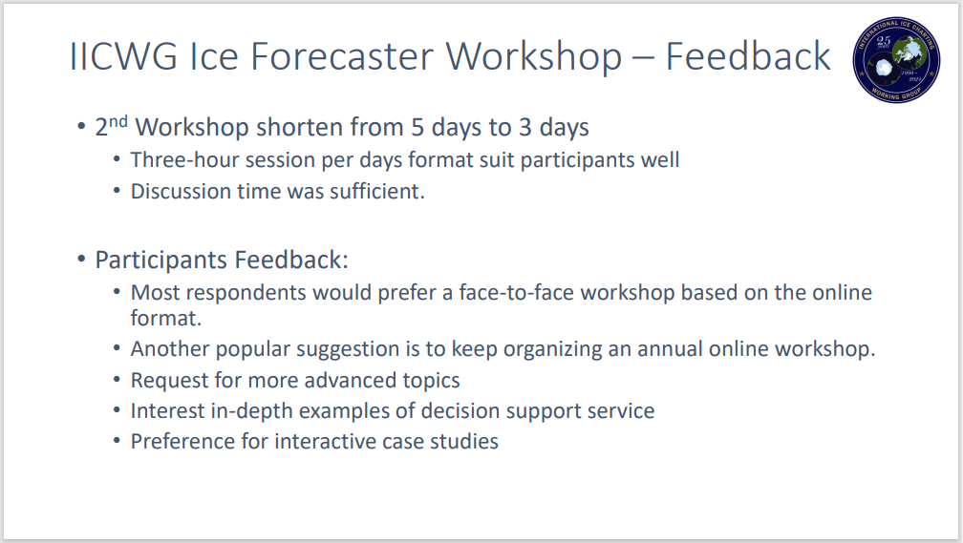


Slide 24
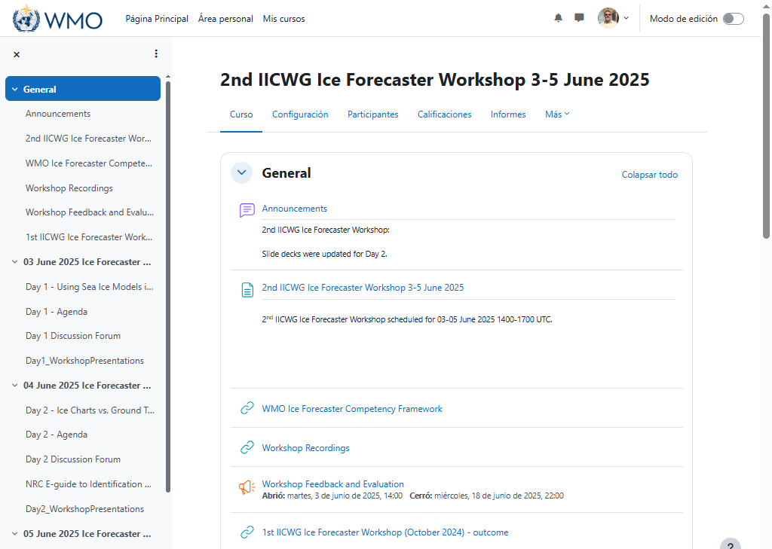

Slide 25
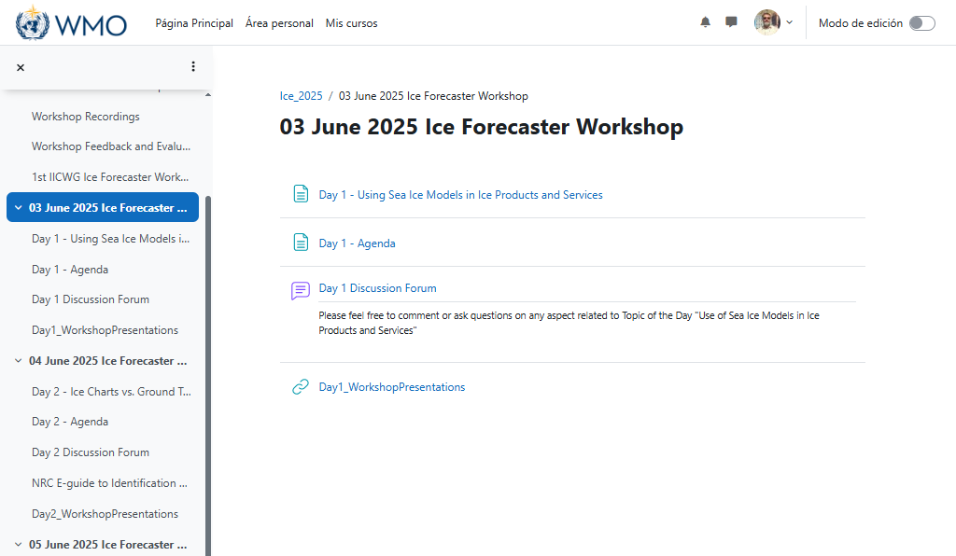
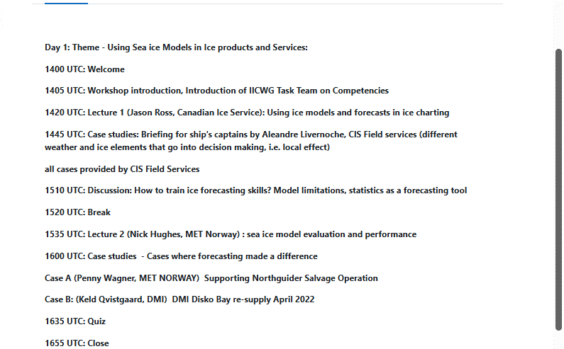

Slide 26
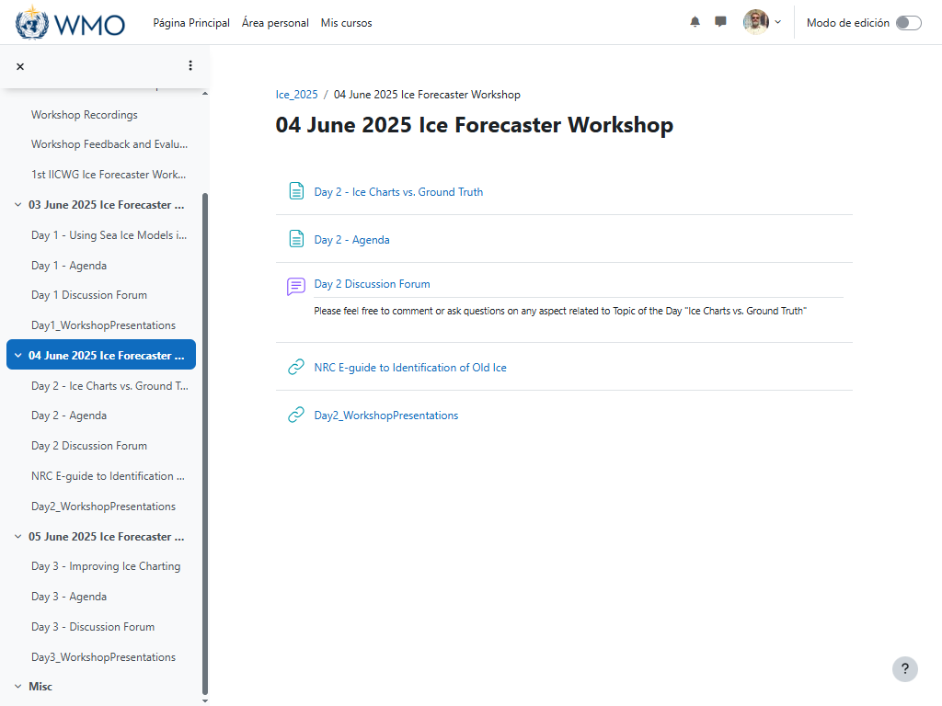
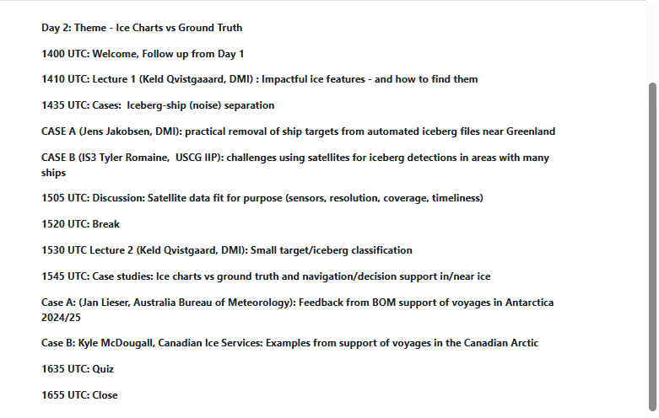

Slide 27
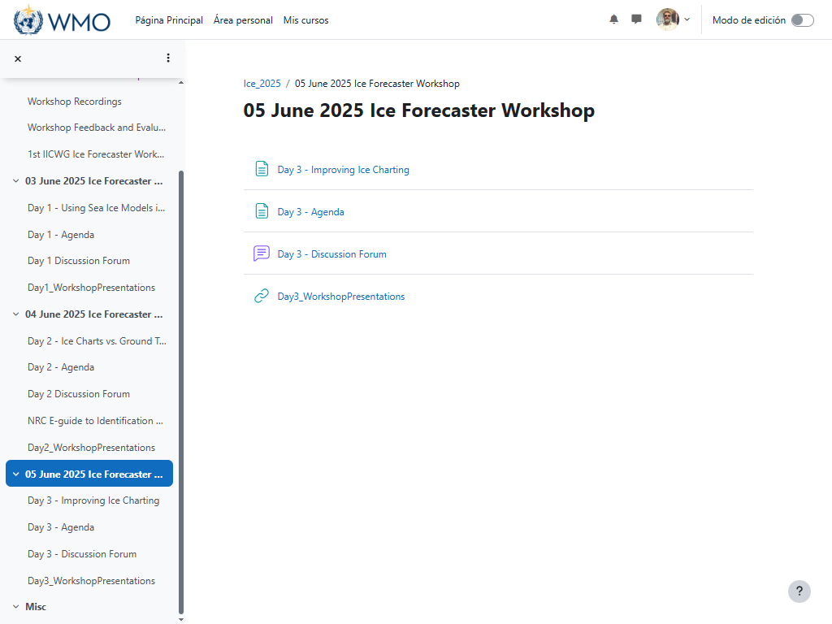
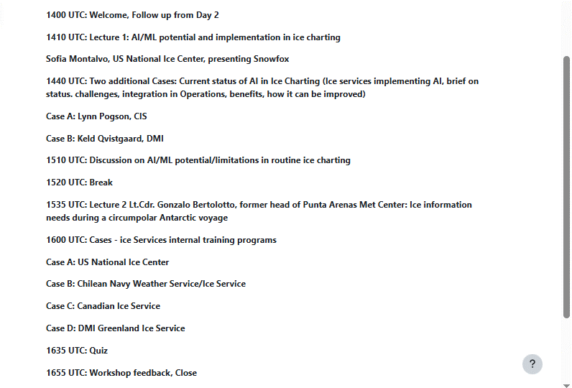

Slide 28
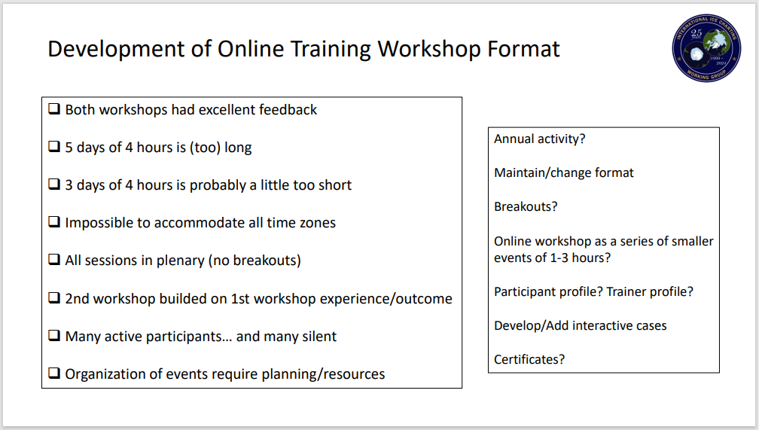

Slide 29
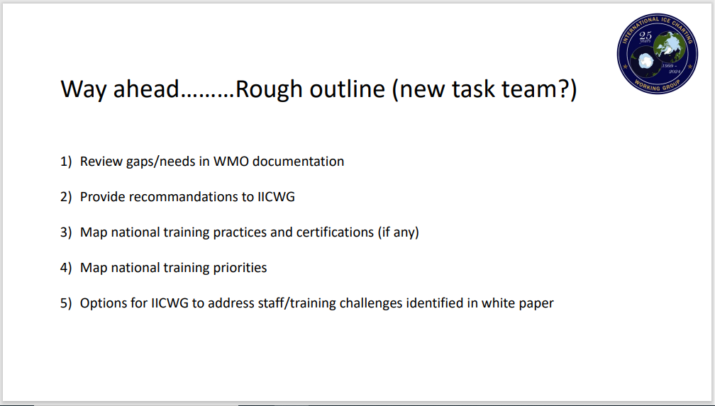

Slide 30
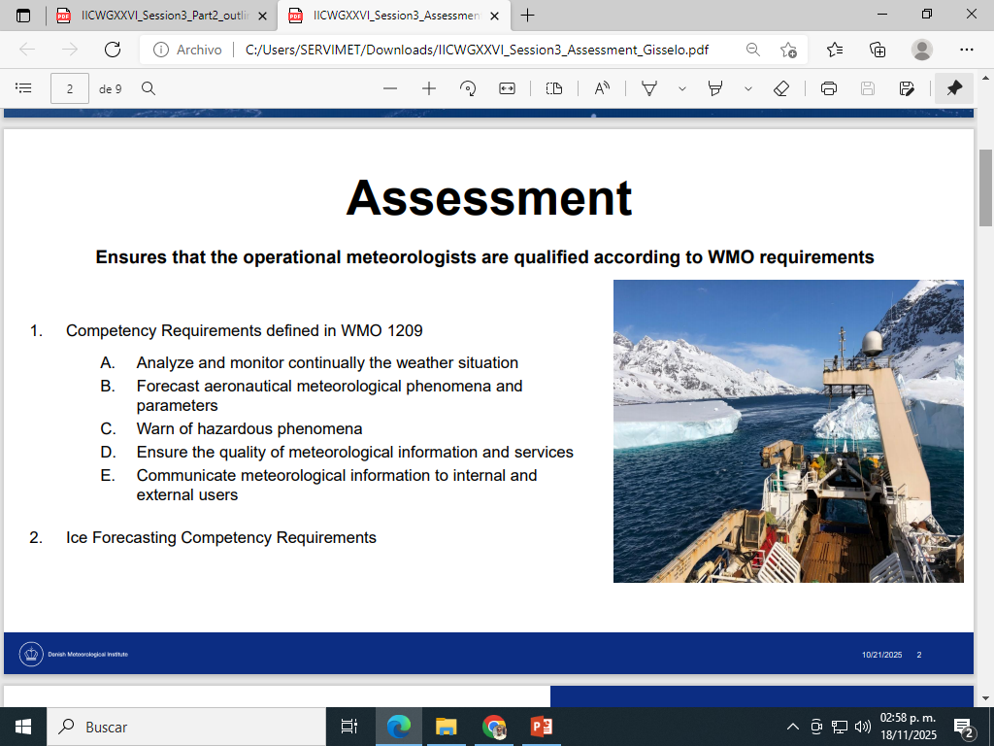


Slide 31



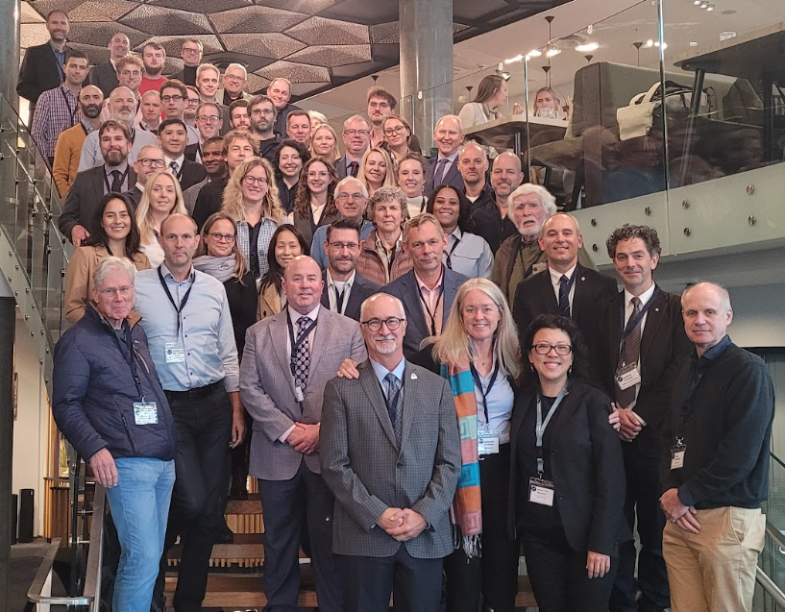




Alejandro de la Maza
Chile Navy Weather Service
AdelaMazaD@dgtm.cl

