Slide 1
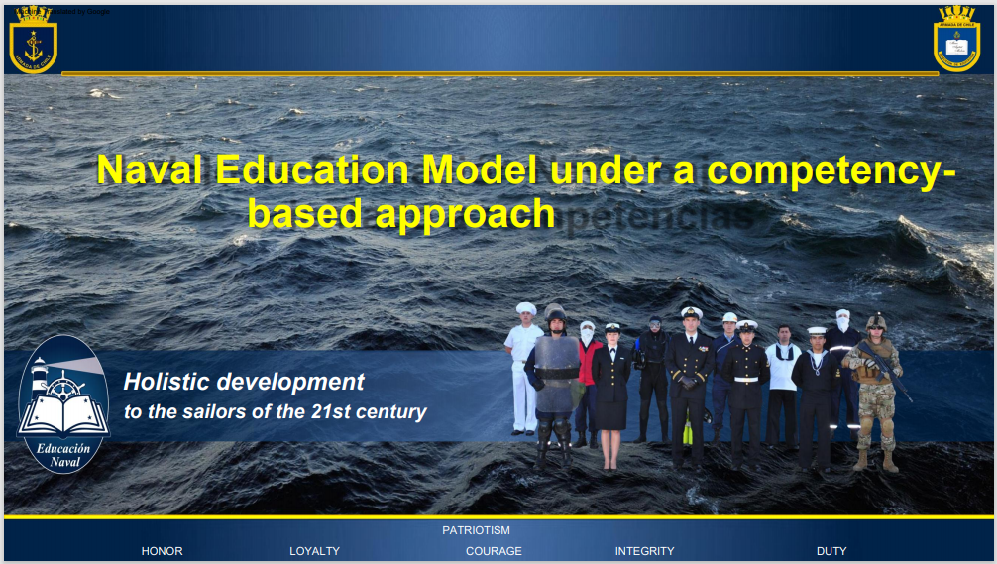


Lt.Cdr. Fernanda de la Maza
Head of Coast Guard School
x-Cdr. Alejandro de la Maza
Chile Navy Weather Service

Slide 2
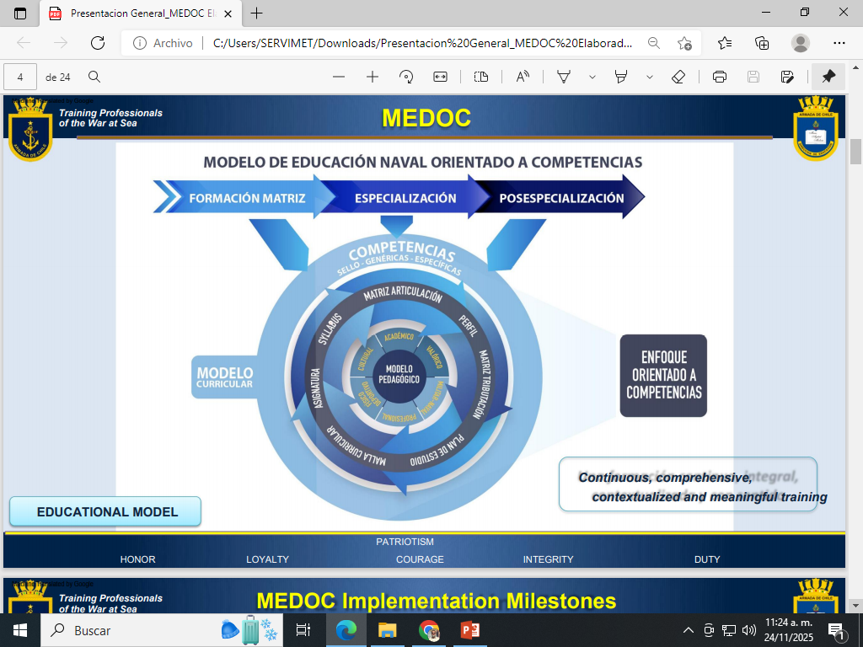
NAVAL EDUCATIONAL MODEL ORIENTED TO COMPETENCIES
FORMATION ESPECIALIZATION POSTGRADUATE
FOCUS ON ORIENTED TO COMPETENCIES
CURRICULAR
MODEL

Slide 3


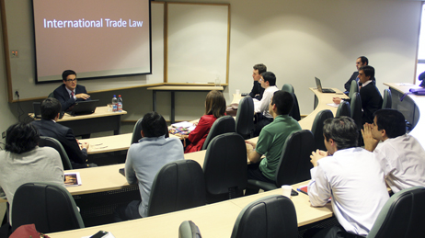
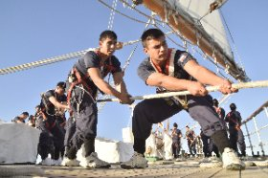
Curricular Conceptions: Differences between a Technological Curriculum vs. a Competency-Based Curriculum
Technological Curriculum
Oriented towards the development of skills
Focused on learning objectives.
Observable, partial behavior, referring to a single skill.
Focused on Teaching and therefore, on the Teacher.
Student's role: passive. Reproducer of knowledge.
Focused on learning outcomes.
Globalized behavior involves the whole person; it is comprehensive and integrated within a specific context.
Focused on the student, on their learning.
Active, collaborative, autonomous student role.

Slide 4

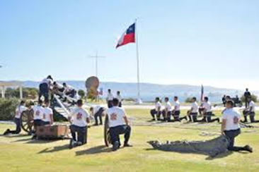
Curricular Conceptions: Differences between a Technological Curriculum vs. a Competency-Based Curriculum
Technological Curriculum
Oriented towards the development of skills
It emphasizes the reproduction of disciplinary knowledge.
Assessment as a means of controlling learning.
Rigid methodologies, focused on the reproduction of learning.
Educational resources intended for rehearsal but not for learning.
It emphasizes creation and reflection on learning.
Assessment as evidence of and for learning.
Interactive methodologies, focused on the appropriation of disciplinary knowledge.
Educational resources intended to support and for learning.

Slide 5
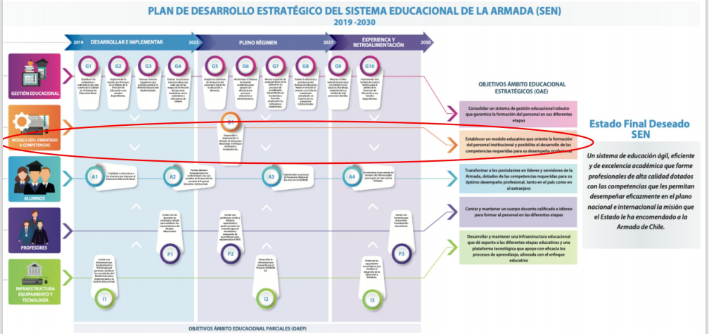
STRATEGIC DEVELOPMENT PLAN FOR THE NAVAL EDUCATIONAL SYSTEM 2019-2030
DEVELOPMENT (2025)
IMPLEMENTATION (2027)
FEEDBACK (2029)
A system of agile, efficient and academic efficiency in education, that trains high-quality professionals, equipped with the competencies that allow them to perform effectively, at the national and international level, in the scope of the missions that the state of chile has entrusted to the navy

Slide 6
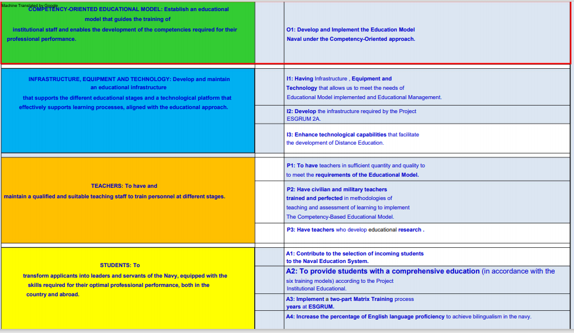

Slide 7
Competence
Declaration of Competence at the Institutional Level
" Competence is understood as the combination of skills, abilities, attitudes, values, and knowledge necessary to perform a specific task. A competence includes both means and an end. The means are knowledge, skills, abilities, attitudes, and values, and the end is to effectively perform the activities or tasks or meet the standards of a given occupation. Without an end, the term competence loses its true meaning."
Source: DEA Directive. F-001, Curriculum design, adjustment and redesign….
Competencies are integrative; they cannot be separated because doing so would diminish their quality as competencies. According to Perreanaud (1997), competencies are complex actions that require the convergence of cognitive, social, and affective resources.
Competencies are not capabilities
Competencies are not skills
"It is the ability to respond to individual or social demands or to perform an activity or task for which it is necessary to carry out a combination of interrelated practical and cognitive skills, knowledge, motivation, values, attitudes.“ Coll . C (2007)

Slide 8
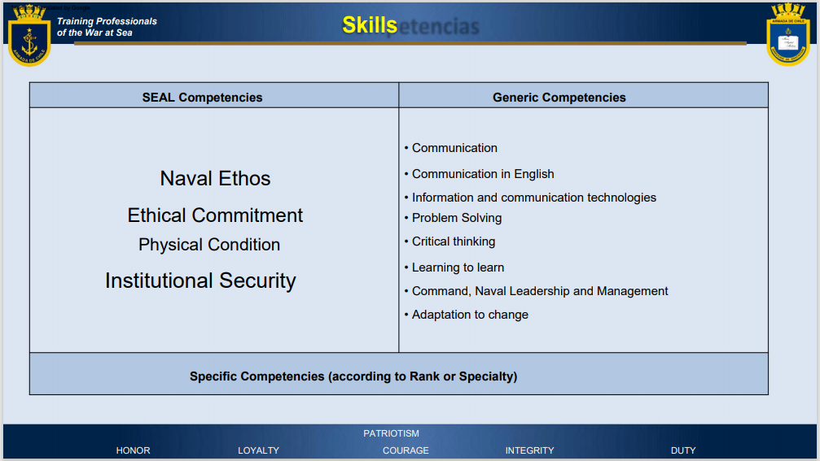
Profiles

Slide 9
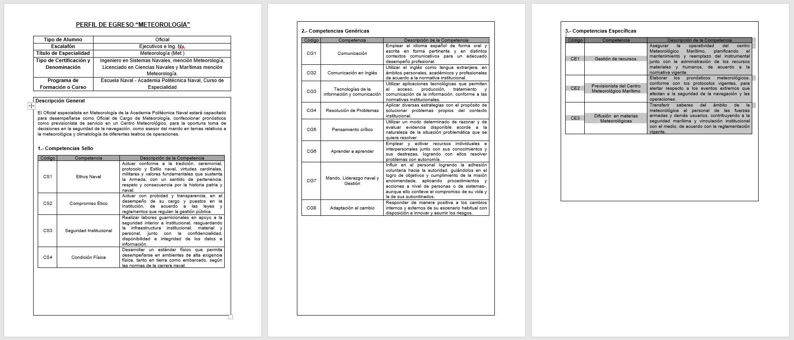

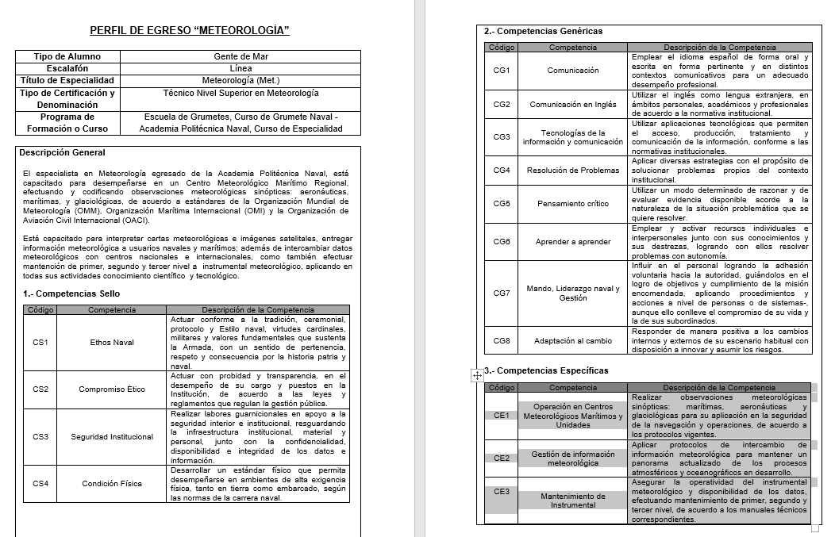
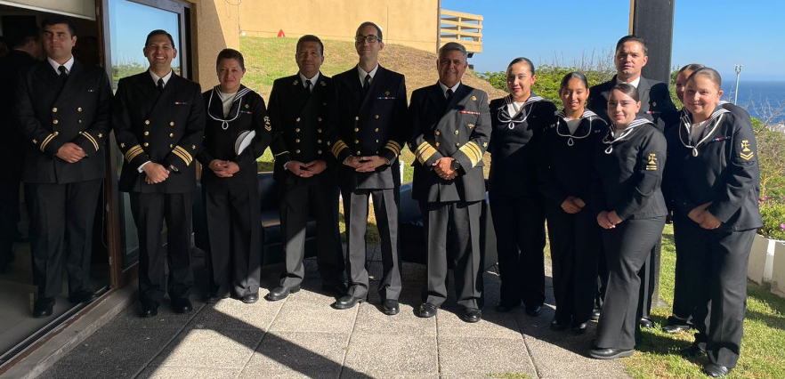

Slide 10
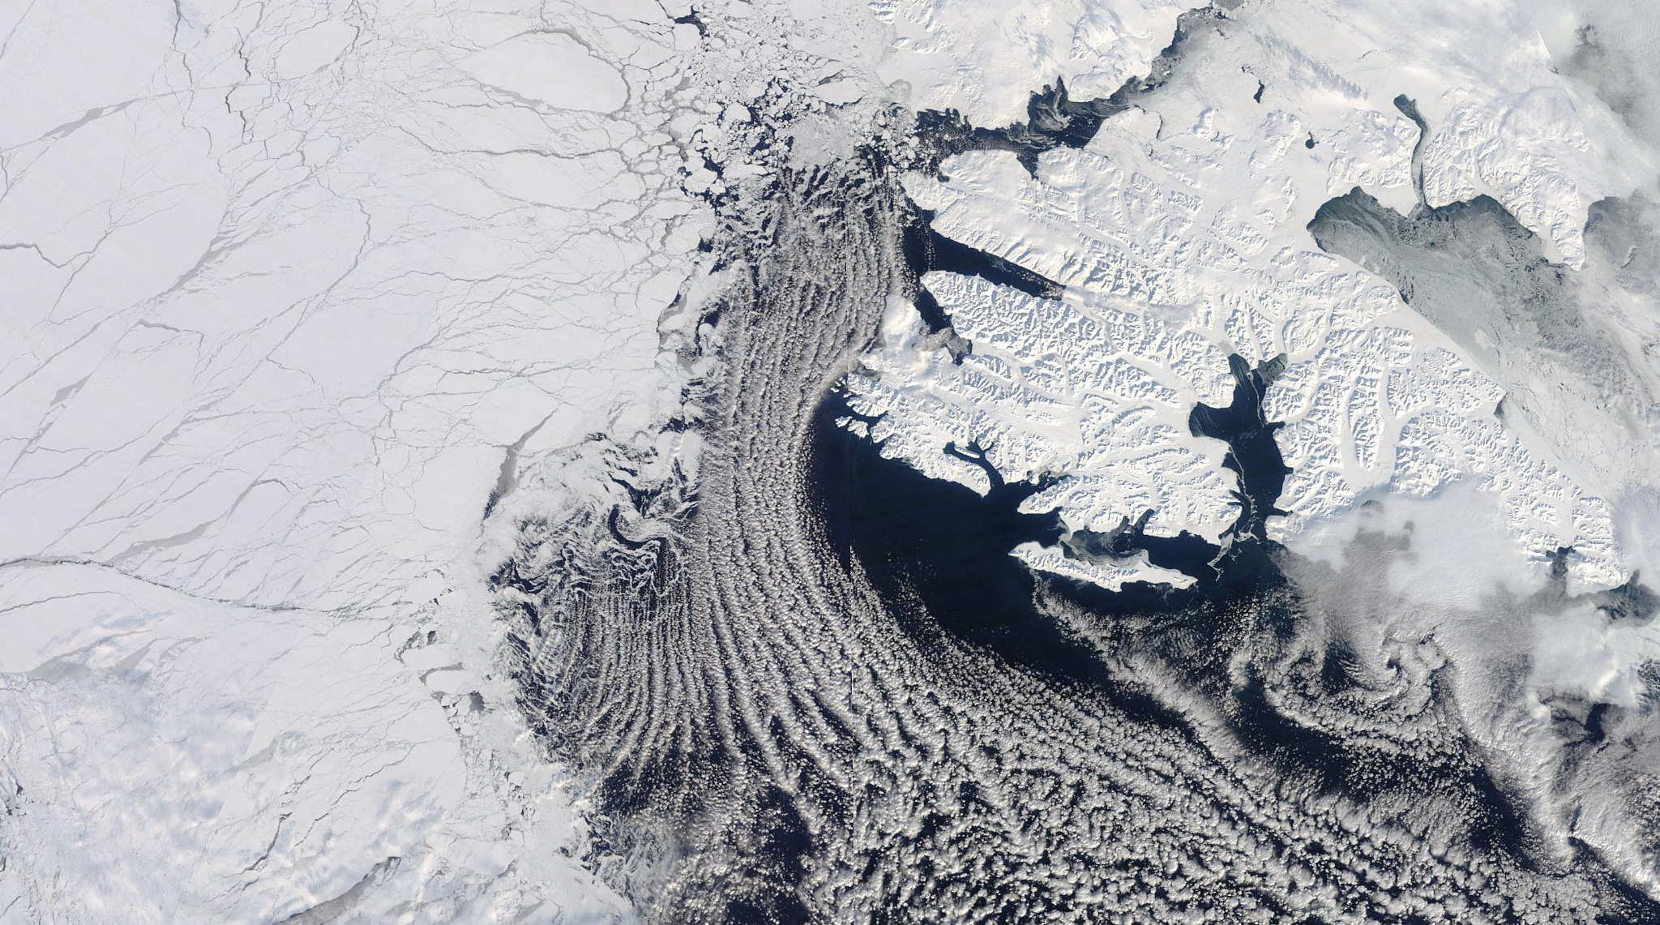



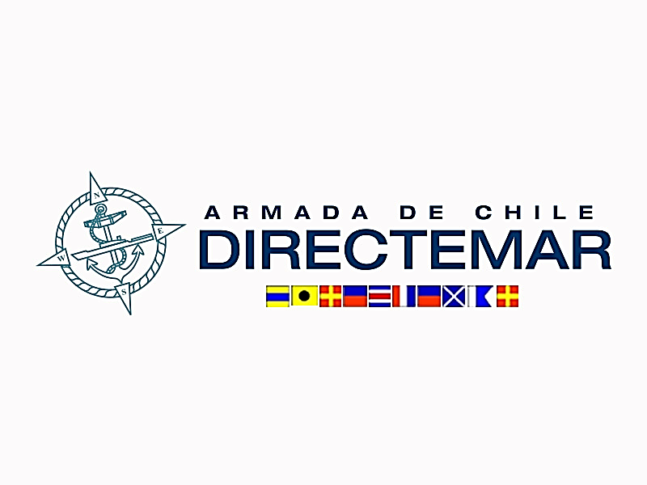
Strategic Guidances:
009 Information for Shipping (2019) vol.D
049 Technical Regulations (2019) Professional Competencies.
471 Guide to Marine Meteorological Services (2018)
558 Manual on Marine Meteorological Services (2018)
574 Sea-ice Information and Services (2024)
834 Guide to Public Weather Services Practices (2000)
1129 Strategy for service delivery and its implementation plan (2014)
1150 Guidelines on Multi-hazard Impact-based Forecast and Warning Services (2015, 2018, 2021)
1205 Guide to Meteorology General Competencies (2018)
1293 Guidelines on Implementation of a Coastal Forecasting & Early Warning Systems (2022)
CE 76 Competencies Framework on Ice Analysts and Forecasters (2023)
SOLAS Chapter V: “Safety of Navegation”, Rule 5: “Weather Warning Services (edition 2020)
MSC 102/22/3 Maritime Security Committe Audit Scheme (2022)
MSC 1293 Participation on the VOS scheme (2018)
MSC 1310 Joint IMO+IHO+WMO related to MSI (2014)
MEPC 8/15/2 Maritime Environmental Protection Committee, about RSMC.MER (2023)
O-41/001 Safety Mesures for Weather Conditions (2021)
DS(M)392 Maritime Telecommunications System (2001)
DS(M)397 & 398 Piloting and Shipping Regulations (1985)
Notes:
Guidance: Please provide your strategic governing information from your nation on these slides...have as many slides as you wish. I just created 1 here as a placeholder. Keep in mind we have 8-10 minutes for each presentation. Some guidance on content:
Itemize various policy setting documents or guidance to support and guide ice work/operations: WMO 9.vol.D, 49, CE 76, 471, 558, 574, 834, 1129, 1150, 1205, 1293, SOLAS.chap.V.rule.5, IMO.MSC 102/22/3, 470, 1293, 1310, IMO.MEPC 8/15/2
Are these old policy documents (1974-78) or new (2024)? Is there any strategic governing documents being updated or generated now? SOLAS.chap.V.rule.6 is proposed to be updated by IICWG.TT while the WMO and IMO publications are under review by AG.WWMIWS.SubC and WWNWS from IHO.
What marine and ice priorities are called out within any of your policy documents? Ice accretion and monitoring, early warnings for all, impact based forecasts, radio signals, future development of the electronic charting displays series S-411 (S-412, S-413, S-414).
Anything else you wish to provide. Feel free to provide examples of new products and services? What about any research to ops projects that will support ice operations? Etc. professional competencies framework and Antarctic science collaboration

Slide 11
Technicians (seamen’s crew)
Code | Competencies | Descriptions
CE1 | Operator on board vessels, land base stations and Marine Weather Centers | Conduct synoptic meteorological observations: maritime, aeronautical and glaciological, for application in the safety of navigation and operations, in accordance with current protocols.
CE2 | Meteorological Information Management | Implement meteorological information exchange protocols to maintain an up-to-date overview of developing atmospheric and oceanographic processes.
CE3 | Instrumental Manteinance | Ensure the operability of meteorological instruments and the availability of data by performing first, second, and third level maintenance, in accordance with the corresponding technical manuals.

Slide 12
Executive (engineer officers)
Code | Competencies | Descriptions
CE1 | Resources Management. | Ensure the operational readiness of the Maritime Meteorological Center by planning the maintenance and replacement of instruments, along with the management of material and human resources, in accordance with current regulations.
CE2 | Maritime Weather Center Forecaster Analyst | Prepare weather forecasts, in accordance with current protocols, to provide alerts regarding extreme events that affect the safety of navigation and operations.
CE3 | Meteorological Communicator | To transfer knowledge in the field of meteorology to armed forces personnel and other users, contributing to maritime safety and institutional linkage with the environment, in accordance with current regulations.

Slide 13

Medoc Stages (years 2024-2026...)
 | 2023-2024 | 2024 | 2024 | 2024 | 2025 | 2026
Areas | Stage 3 *Definition of curricular activities/subjects. *Taxations of Competencies to Curricular activities and subjects. | Stage 3 *Definition of Curriculum Structure. Mesh *Credit Allocation. | Stage 3 *Content network: Articulation between subjects and core training. | Stage 4 *Elaboration Course syllabus. *Training on curricular elements used in a competency -based curriculum . | Stage 5 Implementation: Syllabus Training in Methodologies and Evaluation. | Stage 6: Curriculum Monitoring.
Infantry |  |  |  | In progress
Gathering |  | In progress
Coast Guard |  |  |  | In progress
Health | In progress
Weapon Systems |  | In progress
Engineering
Operations | In progress
Special Forces |  |  |  | In progress

Slide 14
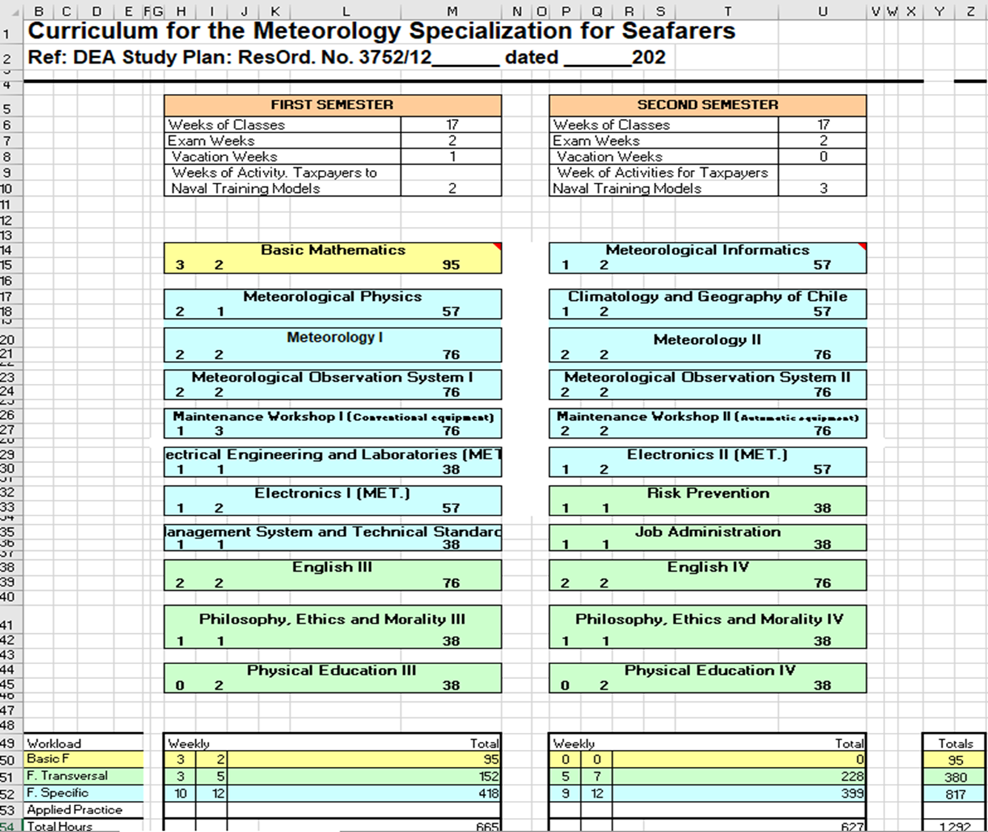
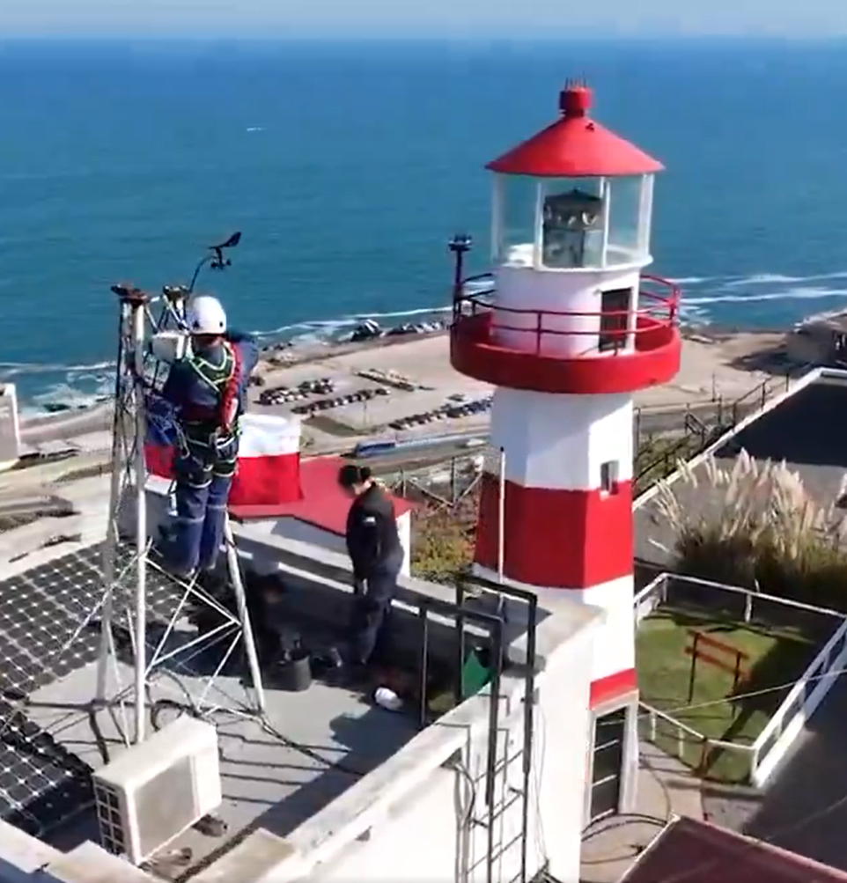

Slide 15
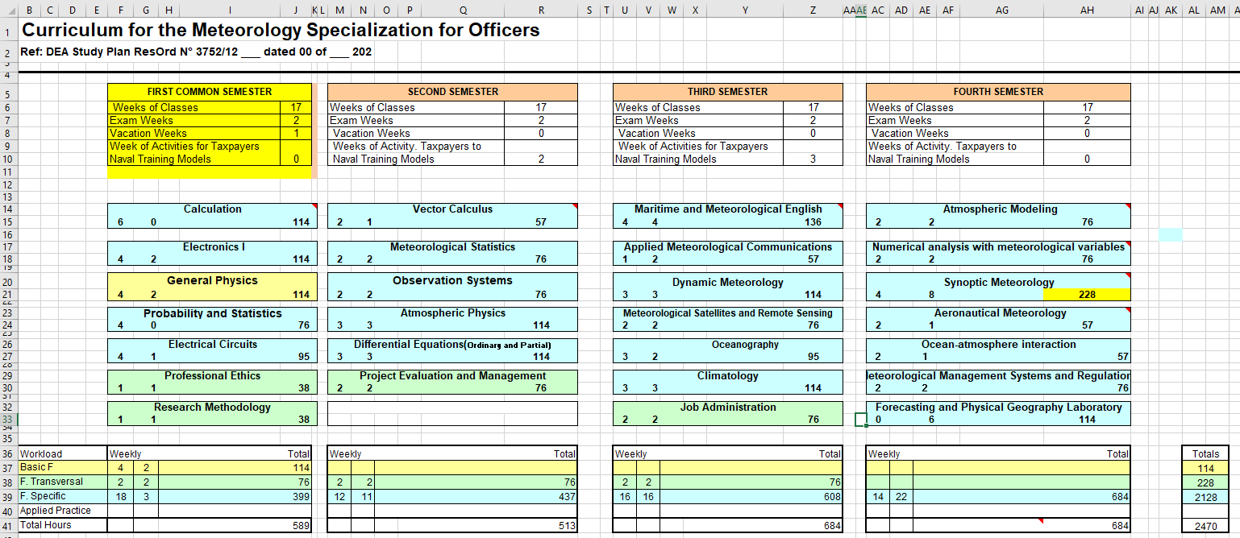

Slide 16
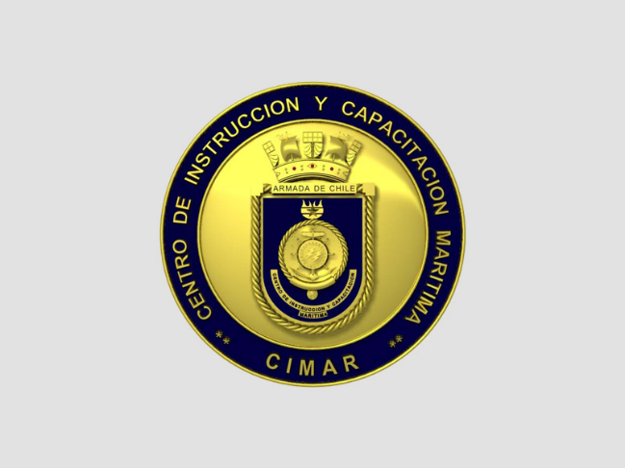
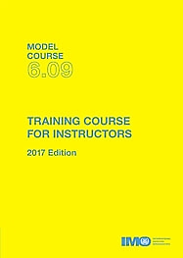

Curriculum Design Oriented to the Development of Competencies
Quality Assurance Unit
Area of Analysis, Development and Curriculum Innovation
Mg. Mrs. Cecilia Robledo Güiraldes
Dr. Erna Díaz Cruz.

Slide 17
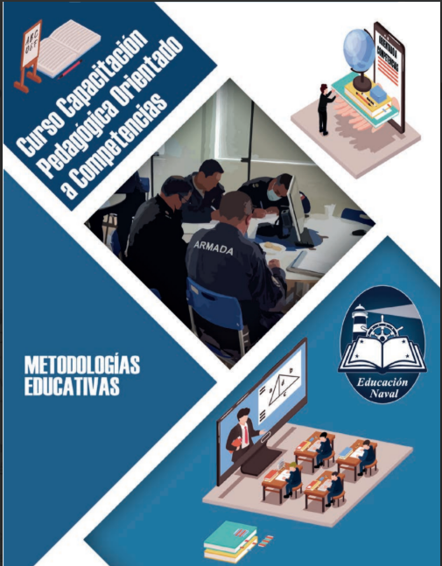
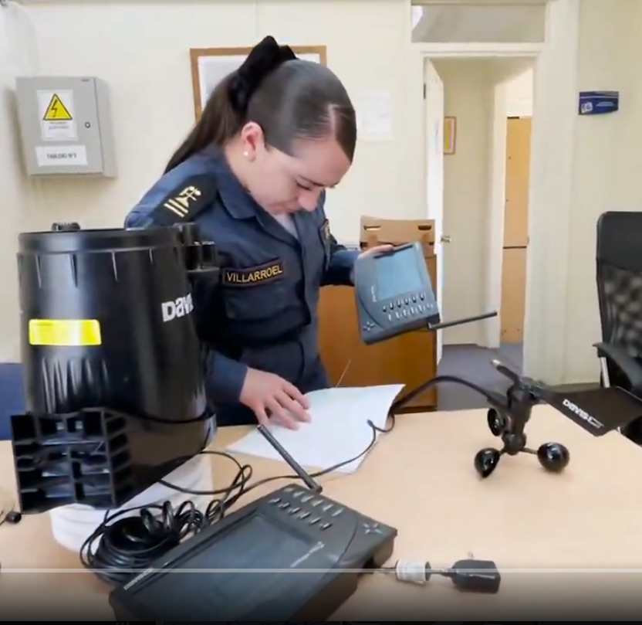
Competency Based Pedagogical Course for Trainers
EDUCATIONAL METODOLOGIES

Slide 18
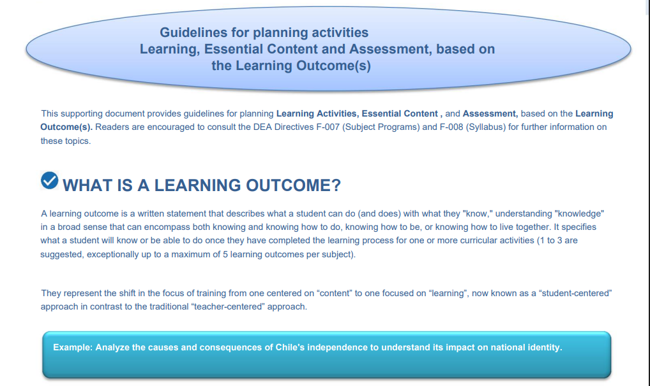

Slide 19
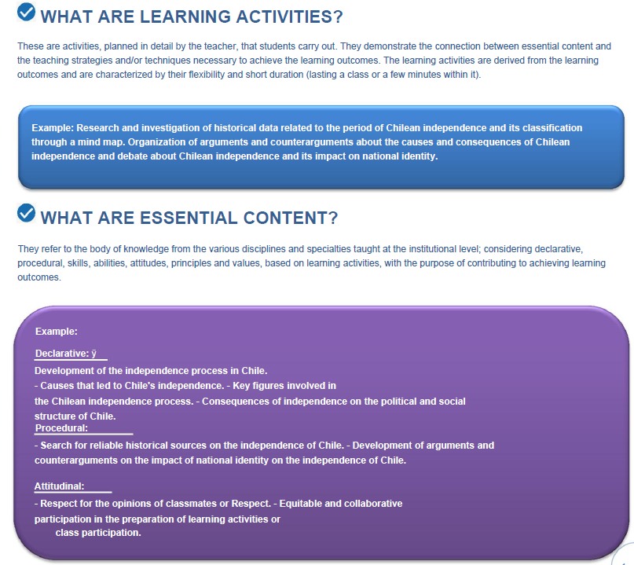

Slide 20
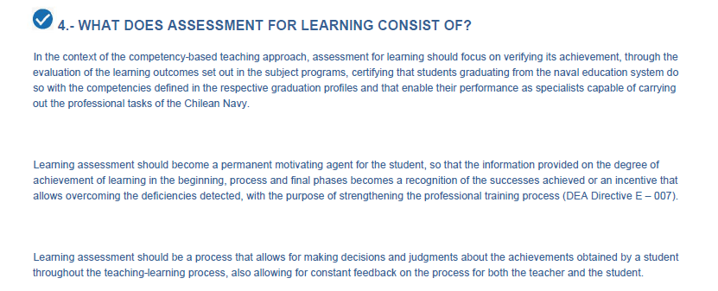

Slide 21
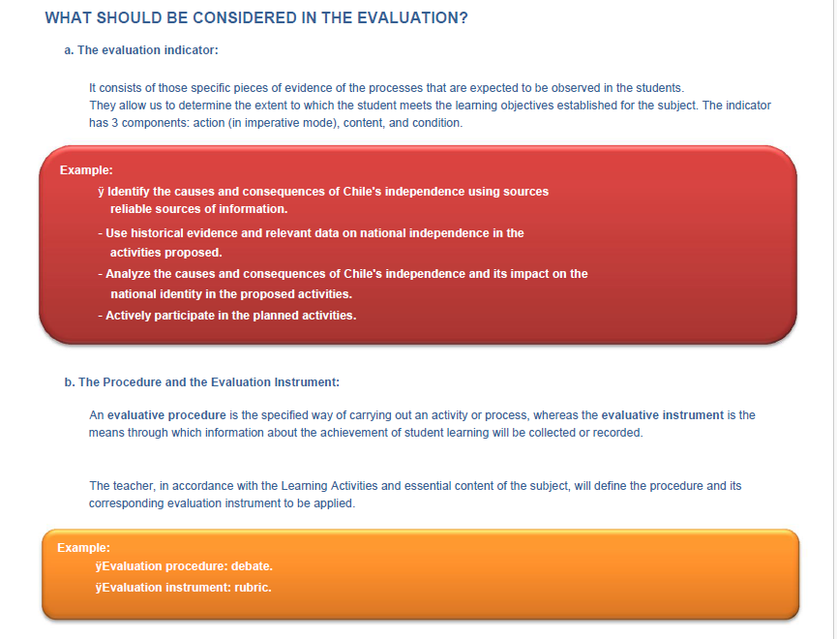

Slide 22
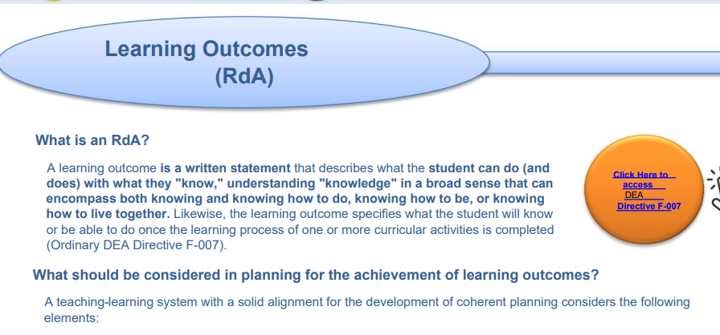
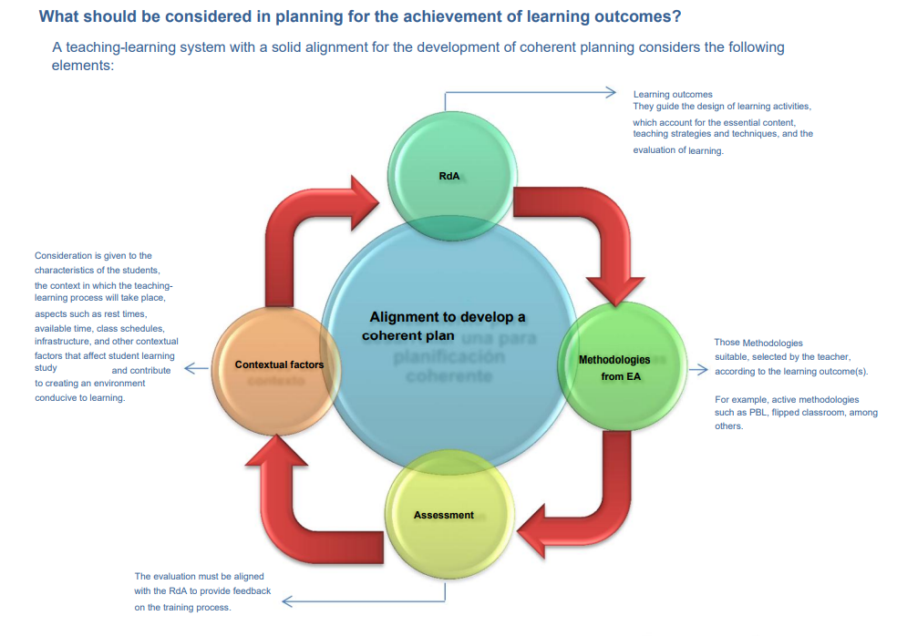

Slide 23
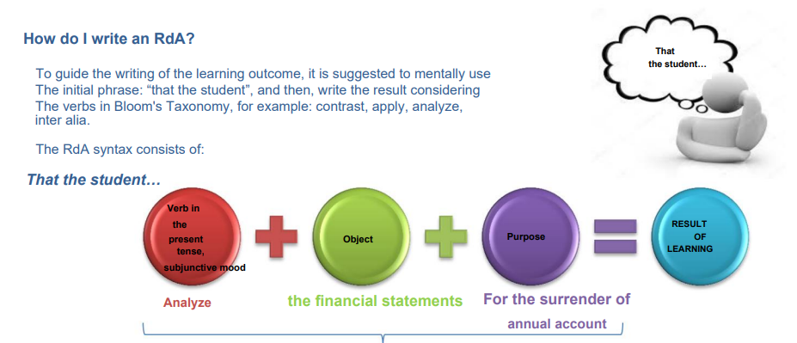

Slide 24
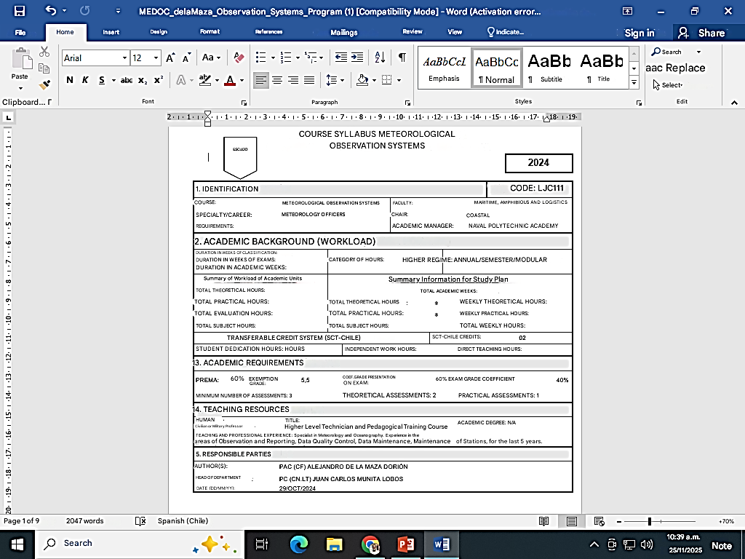

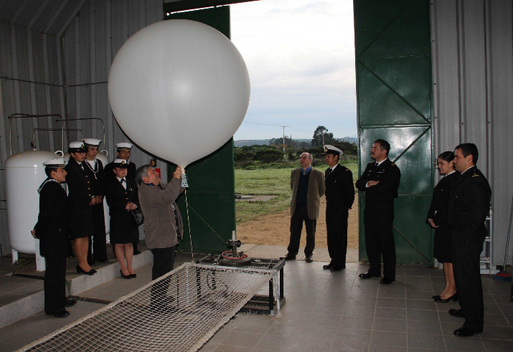
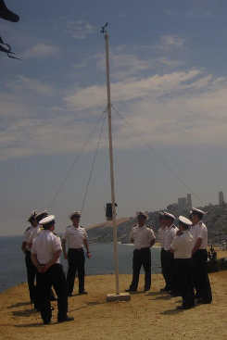
Online resources: Meteorology courses on MOOCs, ETRP, OTGA, and COMET EDU Resources and documents from the World Meteorological Organization WMO videos, documentaries, and graphics showing the observation of meteorological phenomena | Measuring Instruments: thermometers, hygrometers, barometers, barographs, anemometers, rain gauges, radio soundings, automated weather stations | 1. Laboratories equipped for meteorological data analysis and forecast simulations. 2. Automatic weather stations for continuous environmental monitoring. 3. Spaces for installing conventional instruments to conduct observation exercises. | Classrooms with presentation equipment, internet access and audiovisual resources. | 1. TurboWin data visualization and reporting software 2. Professional visits to Santo Domingo Aeronautical Meteorological Station (radio sounding launch) and Point Panul Lighthouse Coastal Synoptic Station, in San Antonio.

Slide 25
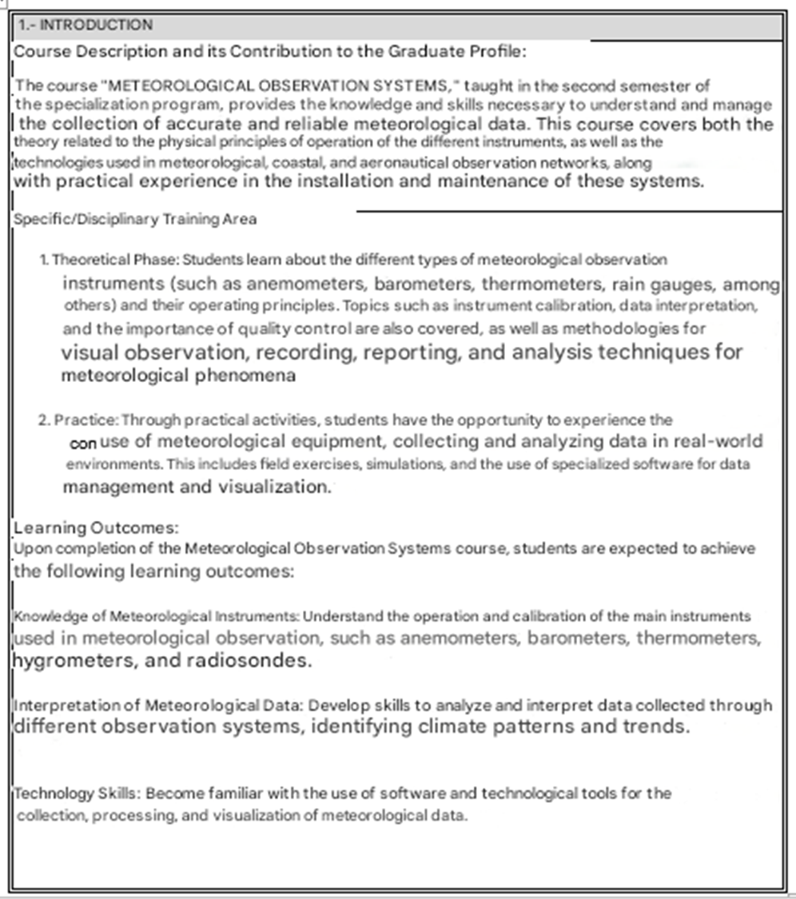
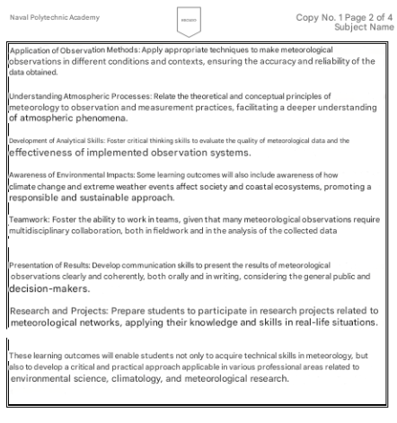

Slide 26
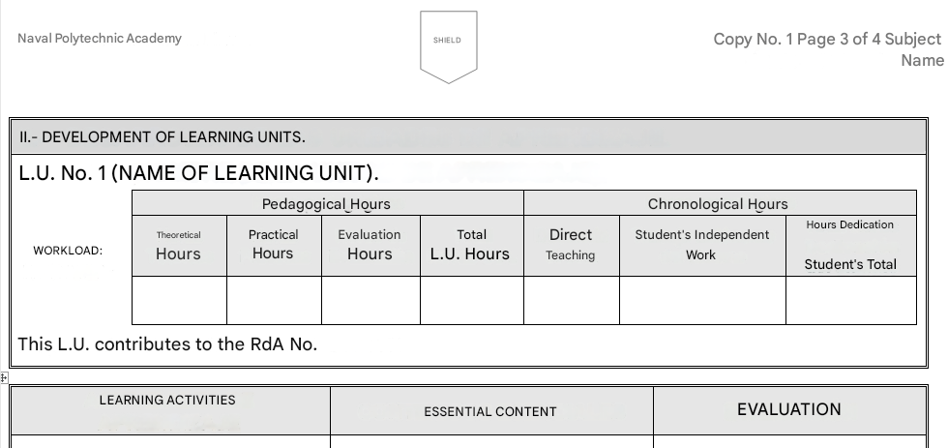
Objective: To foster an understanding of the different atmospheric parameters and their interrelation with daily conditions. Duration: 1 class (2 hours). 2. Case Study: Analysis of Real Meteorological Data Description: A dataset from a local weather station is provided for one month. Students analyze the data to identify significant meteorological trends and events (temperature trends, precipitation patterns, etc.). Objective: Practical application of data analysis techniques to meteorological observation. Duration: 2 classes (4 hours). 3. Weather Station Simulation Description: Using visualization software, students operate a remote weather station. They must collect and analyze real-time data and present their findings. Objective: To understand the operation and importance of weather stations in data collection. Duration: 1 class (2 hours). | 2. Factual Content This focuses on the specific facts and data that students should know: History of Meteorology: Evolution of observation and prediction techniques. Meteorological Stations: Location, operation, and maintenance. Meteorological Data: Interpretation of historical records and measurements. Regulations: Data collection protocols and international standards (such as those issued by the World Meteorological Organization). 3. Conceptual Contents This relates to the ideas and theories that underpin meteorology: Composition and structure of the atmosphere. Differences between climate and weather; climate variability and change. 4. Procedural Contents These aspects highlight the practical skills that students should develop: Data Collection: Learning to use and calibrate measuring instruments. | Unit 2: Meteorological Instruments Assessment Indicators: 1. Identification and Operation of Instruments Action: Identify and explain the operation of meteorological measuring instruments. Content: Anemometers, barometers, hygrometers, among others. Condition: Group oral presentation. Procedure: Presentation with visual aids. Instruments: Checklist to evaluate the presentation. 2. Handling of Instruments Action: Demonstrate the correct use of at least three meteorological instruments. Content: Practical handling of the instruments. Condition: Laboratory practice. Procedure: Practical test where students must take measurements. Instruments: Rubric for evaluating practical skills.
These activities are designed to be flexible and adaptable to different learning environments. By combining the use of concept maps, case studies, and practical exercises, an effective link is achieved between the essential content of the subject and modern teaching techniques, fostering active and collaborative learning among students. Concept Map on Meteorological Observation Systems Description: Students create a concept map that includes the key elements of observation systems, such as weather stations and types of data (temperature, humidity, pressure, precipitation, etc.). | Declarative Contents Theoretical and conceptual knowledge that students should acquire: Definition of Meteorology: Study of the atmosphere and its phenomena.Elements of Climate: Temperature, humidity, atmospheric pressure, wind, precipitation. Measuring Instruments: Thermometers, hygrometers, barometers, anemometers, rain gauges. Types of Observations: Surface observations, atmospheric and oceanic profilers, aeronautical reports, and volunteer vessels. Meteorological Information Systems: Networks of stations, meteorological satellites, numerical prediction models. | Unit 1: Fundamentals of Meteorology Assessment Indicators: Understanding of Basic Concepts Action: Define key meteorological terms. Content: Terms such as temperature, atmospheric pressure, humidity, wind, etc. Condition: Written exam. Procedure: Objective assessment with multiple-choice questions. Instruments: 10-question questionnaire.

Slide 27
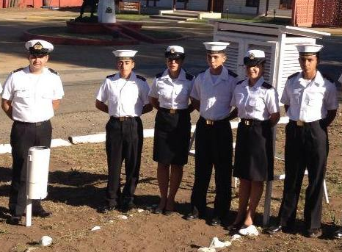
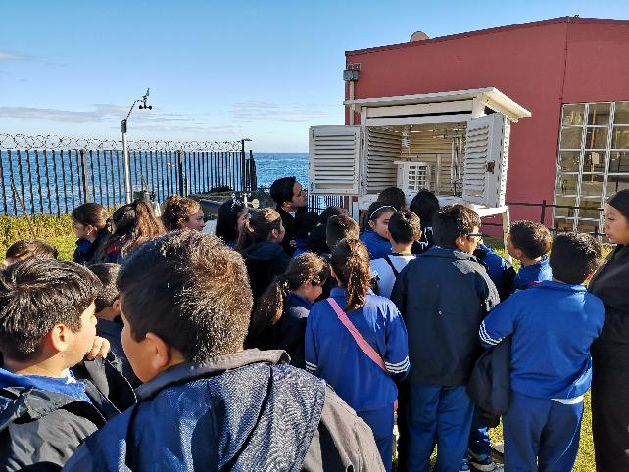
4. Debate on Emerging Technologies in Meteorology Description: A class debate will be held on the impact of new technologies on meteorological observation systems (use of drones, advanced satellite imagery, and artificial intelligence). Students must research and prepare arguments for or against each technique. Objective: To develop critical thinking and teamwork skills. Duration: 1 class (2 hours). 5. Research Project Presentation Description: Students choose an extreme weather phenomenon (storms, fog or snowstorms, heat waves, wildfires, etc.) and present a report on how these events are observed, analyzed, and predicted. Objective: To integrate research knowledge and skills. Duration: 2 classes (4 hours) | Data Analysis: Creating meteorological graphs, tables, and statistics. Simulations and Modeling: Using software to visualize computer-generated weather forecasts. Preparation of Meteorological Reports: Writing and presenting reports based on observations. 5. Attitudinal Content This reflects the attitudes and values ​​that should be fostered in students: Responsibility in Data Collection: Importance of precision and accuracy in scientific activity. Climate Change Awareness: Understanding the relevance of meteorology in the context of the marine and coastal environment. Collaboration: Working in multidisciplinary teams and sharing data and research. Professional Ethics: Practical implications of providing timely information to maritime users. | Unit 3: Processing and Analysis of Meteorological Data Evaluation Indicators: 1. Data Collection and Analysis Action: Collect and analyze meteorological data for one week. Content: Data collection methods (field observation, databases). Condition: Written report. Procedure: Prepare a report that includes graphs and analysis. Instruments: Rubric for evaluating reports. 2. Interpretation of Meteorological Graphs Action: Interpret graphs of meteorological data. Content: Graphs of temperature, pressure, humidity, etc.Condition: Midterm exam. Procedure: Questions on graph interpretation. Instruments: Questionnaire with graphs to interpret.
 |  | Unit 4: Marine Weather Forecasting Evaluation Indicators: 1. Forecasting Action: Create a weather forecast based on meteorological data. Content: Forecasting techniques (modeling, trend analysis). Requirement: Final project. Procedure: Presentation of a 3-day forecast. Instruments: Rubric for project evaluation. 2. Forecast Verification Action: Compare forecasts with actual data and evaluate them. Content: Forecast verification process. Requirement: Group workshop. Procedure: Discussion on the accuracy of previous forecasts. Instruments: Checklist for group discussion.

Slide 28
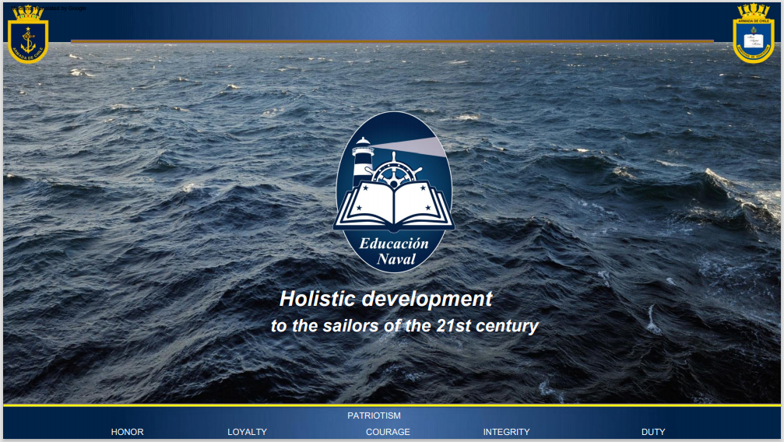

x-Cdr. Alejandro de la Maza
Chile Navy Weather Service
Lt.Cdr. Fernanda de la Maza
Head of Coast Guard School

